Slide 1


School Of Computer Science and Engineering
Topic : Library Management System
Group Members
MOHD JUNAID KHAN (23SCSE1180541)
LAKSHAY (23SCSE1180217)
GOURAV (23SCSE1180335)
Submitted To :- Mr. Kushal Gupta
Course Name :- Java Programing
Course Code :- E1UA307C

Slide 2
School Of Computer Science and Engineering
OUTLINE :-
INTRODUCTION
OBJECTIVE
PROJECT SCOPE
ASSUMPTION
WORK FLOW
CONCLUSION

Slide 3
School Of Computer Science and Engineering
School Of Computer Science and Engineering
INTRODUCTION :-
This project is concerned with developing a Library Management System for Youth Library in order to make library management more efficient and easy to handle. The Library management system enables a fully automated library service. It has the ability to display the details of the books available in various departments, the transactions of books and about the book holders
The goals of this project are to provide simplicity as well as security and efficiency to the management of Agape Youth Library and also reduce managing personnel in the library

Slide 4
School Of Computer Science and Engineering
School Of Computer Science and Engineering
OBJECTIVE :-
It provides "better and efficient" service to members.
2. Reduce the workload of librarian.
3. Faster retrieval of information about the desired book.
4. Provide facility for proper monitoring reduce paper work and provide data security.
5. All details will be available on a click for both user and librarian.

Slide 5
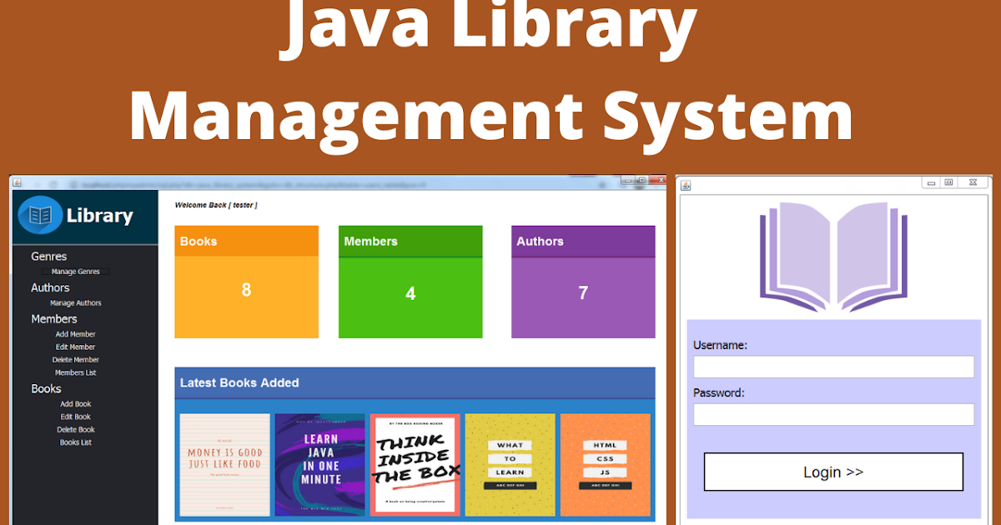
School Of Computer Science and Engineering
School Of Computer Science and Engineering
PROJECT SCOPE :-
Many libraries are operated manually by a group of people. These people keep records regarding the books & students (borrowers), check the books manually and keep records on issued books. All these things have to be carried out manually and if the library is very large, proper record keeping will become a major problem as manual record keeping has never been a reliable method because people tend to forget things.

Slide 6
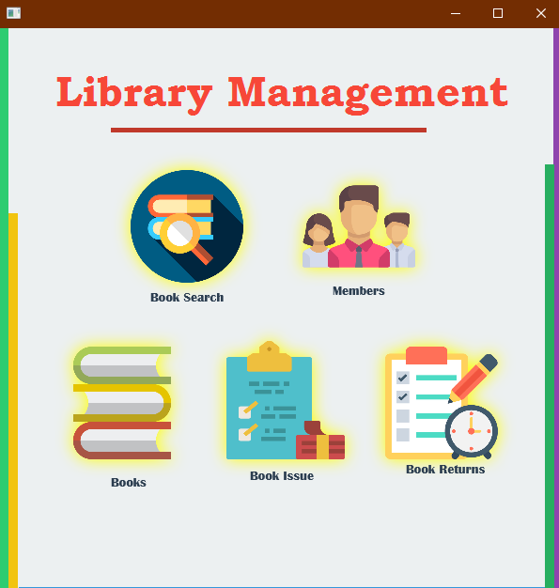
School Of Computer Science and Engineering
School Of Computer Science and Engineering
ASSUMPTION :-
Fast report generation is not possible
Tracing a book is difficult
Other problems of the existing system are:
Information about issue/return of the books is not properly maintained
No central database can be created as information is not available in database

Slide 7
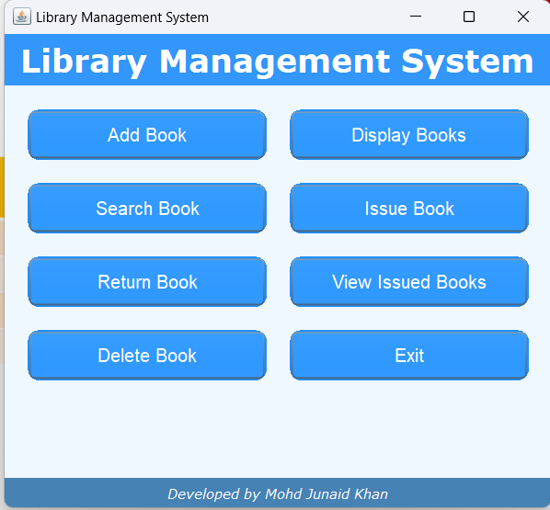
School Of Computer Science and Engineering
School Of Computer Science and Engineering
PRODUCT FUNCTION :-
A Activities of the Borrower | Activities of the Administrator | Activities of the librarian
Search for a book | Add/Delete books | Issue books
Borrow a book | Maintain the database | Return books
View user details | View user details | Add/delete books
Modify user details | Maintain user details

Slide 8
School Of Computer Science and Engineering
School Of Computer Science and Engineering
Start
Home page
Delete Book
View Book
WORKFLOW:-
Add Book
Book Title
Book Auth
Publication Year
Select Book
Select Book
End

Slide 9
School Of Computer Science and Engineering
School Of Computer Science and Engineering
CONCLUSION:-
The Library management system needs to be computerized to reduce human errors and to increase the efficiency.
The proposed Library management system in this proposal will be a computerized management system developed to maintain all the daily work of library.
Library management systems are designed to store all the information about books and members.
The main focus of this project is to lessen human effort and encourage efficient record keeping.

Slide 10
School Of Computer Science and Engineering
School Of Computer Science and Engineering
THANK YOU

